Slide 1
Lecture 11: Recurrent Neural Networks 2

Slide 2
Long Short-Term Memory
Handles long-term dependencies
Leaky units where weight on self-loop α is context-dependent
Allow network to decide whether to accumulate or forget past info

Slide 3
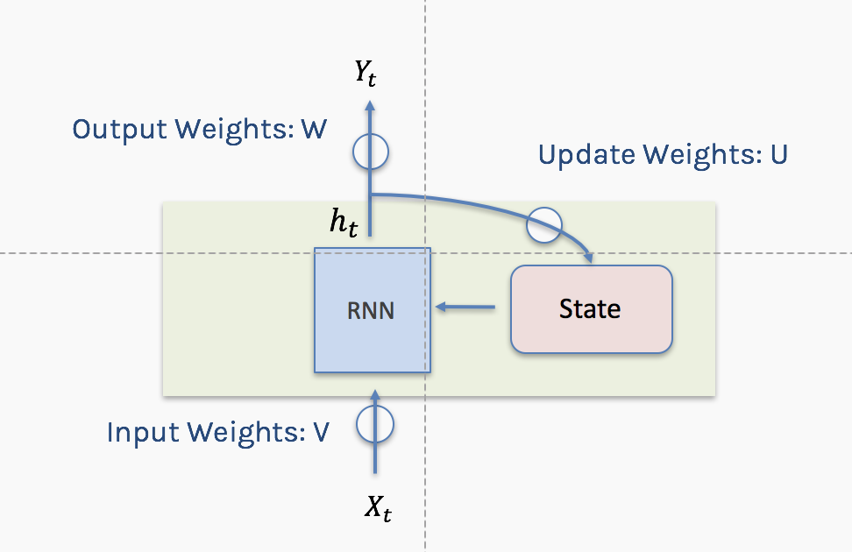
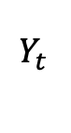
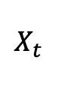
Notation
Using conventional and convenient notation
$$Y_{t }$$
$$X_{t }$$

Slide 4
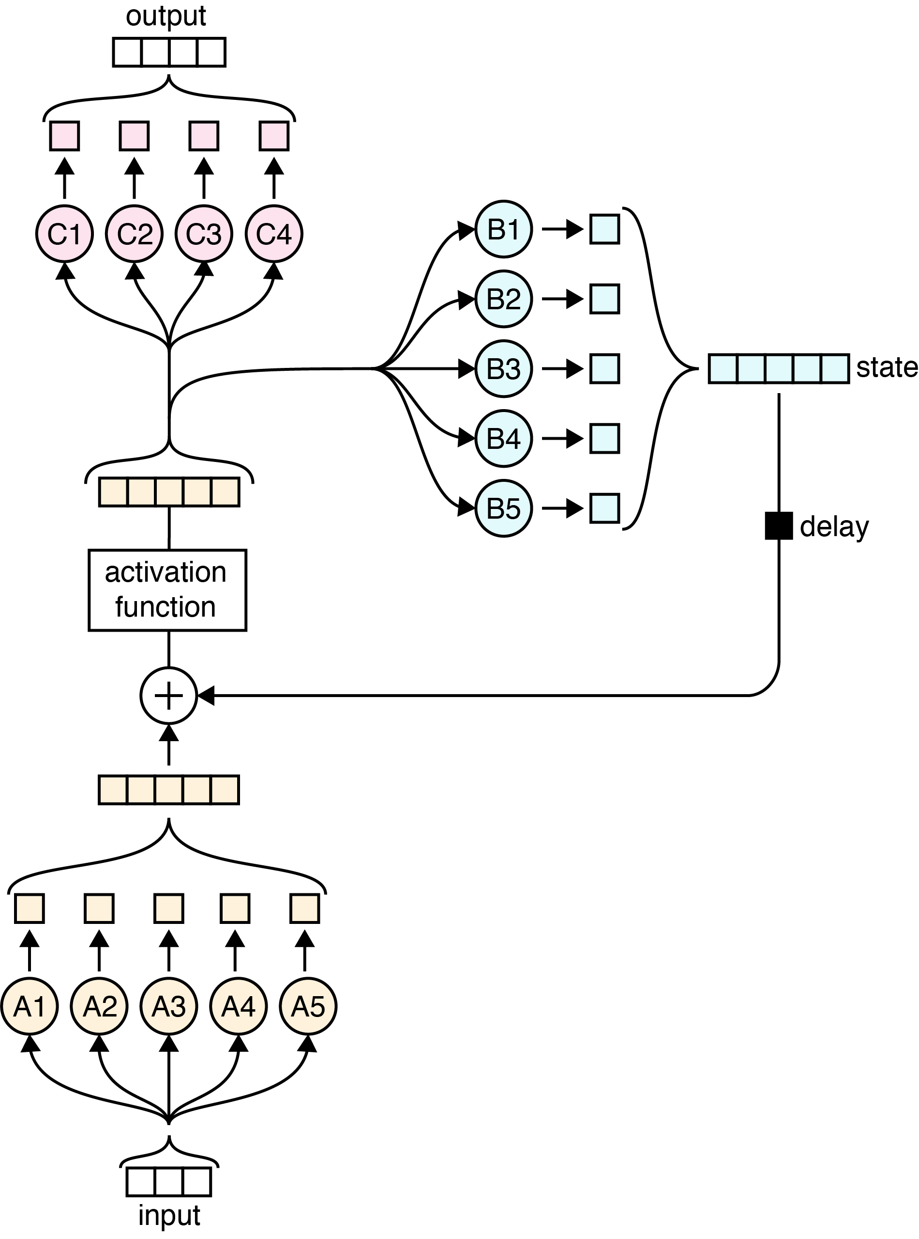
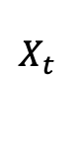
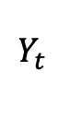
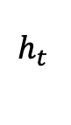
Simple RNN again
$$Y_{t }$$
σ
W
$$h_{t }$$
State
σ
+
U
V
$$X_{t }$$

Slide 5
Simple RNN again
$$Y_{t }$$
σ
W
$$h_{t }$$
State
σ
+
U
V
$$X_{t }$$

Slide 6

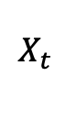
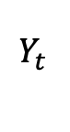
Simple RNN again: Memories
$$Y_{t }$$
σ
W
$$h_{t }$$
State
σ
+
U
V
$$X_{t }$$

Slide 7
Simple RNN again: Memories - Forgetting
$$Y_{t }$$
σ
W
$$h_{t }$$
State
σ
+
U
V
$$X_{t }$$

Slide 8
Simple RNN again: New Events
$$Y_{t }$$
σ
W
$$h_{t }$$
State
σ
+
U
V
$$X_{t }$$

Slide 9
Simple RNN again: New Events Weighted
$$Y_{t }$$
σ
W
$$h_{t }$$
State
σ
+
U
V
$$X_{t }$$

Slide 10
Simple RNN again: Updated memories
$$Y_{t }$$
σ
W
$$h_{t }$$
State
σ
+
U
V
$$X_{t }$$

Slide 11
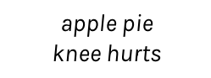
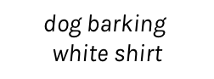
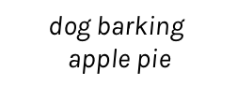
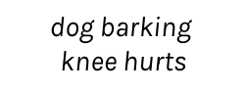
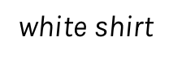
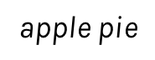
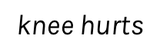
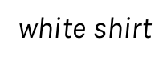
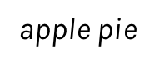
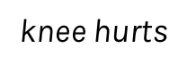
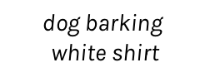
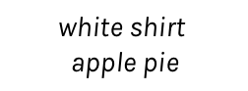
RNN + Memory
0.3
0.1
0.1
0.4
0.6
-------
-------
-------
dog barking
$$\text{dog} \text{barking}$$
$$\text{white} \text{shirt}$$
$$\text{white} \text{shirt}$$
$$\text{apple} \text{pie}$$
$$\text{apple} \text{pie}$$
$$\text{knee} \text{hurts}$$
RNN
RNN
RNN
RNN
RNN
dog barking
$$\text{white} \text{shirt}$$
$$\text{apple} \text{pie}$$
$$\text{knee} \text{hurts}$$
get dark
0.3
0.1
0.1
0.6
0.9
-------
-------
-------
dog barking
$$\text{dog} \text{barking}$$
$$\text{white} \text{shirt}$$
$$\text{dog} \text{barking}$$
$$\text{apple} \text{pie}$$
$$\text{dog} \text{barking}$$
$$\text{knee} \text{hurts}$$
RNN
RNN
RNN
RNN
RNN
dog barking
$$\text{white} \text{shirt}$$
$$\text{apple} \text{pie}$$
$$\text{knee} \text{hurts}$$
get dark

Slide 12
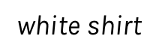
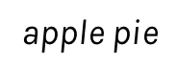
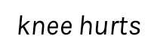
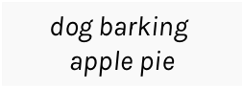
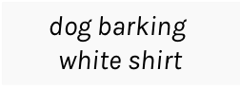
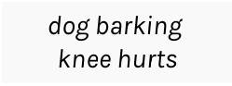
RNN + Memory + Output
0.3
0.1
0.1
0.6
0.9
-------
-------
-------
dog barking
$$\text{dog} \text{barking}$$
$$\text{white} \text{shirt}$$
$$\text{dog} \text{barking}$$
$$\text{apple} \text{pie}$$
$$\text{dog} \text{barking}$$
$$\text{knee} \text{hurts}$$
RNN
RNN
RNN
RNN
RNN
dog barking
$$\text{white} \text{shirt}$$
$$\text{apple} \text{pie}$$
$$\text{knee} \text{hurts}$$
get dark

Slide 13

LSTM: Long short term memory

Slide 14
Gates
A key idea in the LSTM is a mechanism called a gate.

Slide 15
Forgetting
Each value is multiplied by a gate, and the result is stored back into the memory.

Slide 16
Remembering
Remembering involves two steps.
We determine how much of each new value we want to remember and we use gates to control that.
Remember the gated values, we merely add them in to the existing contents of the memory.

Slide 17
Remembering (cont)

Slide 18
Updating
To select from memory we just determine how much of each element we want to use, we apply gates to the memory elements, and the results are a list of scaled memories.

Slide 19
LSTM
C_{t-1}
C_{t}
Y_{t-1}
Y_{t}

Slide 20
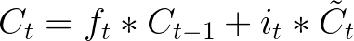
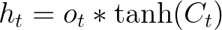
Before to really understand LSTM lets see the big picture …
Output Gate
Cell State
Input Gate
Forget Gate

Slide 21
LSTM are recurrent neural network with a cell and a hidden state, boths of these are updated in each step and can be thought as memories.
Cell states work as a long term memory and the updates depends on the relation between the hidden state in t -1 and the input.
The hidden state of the next step is a transformation of the cell state and the output (which is the section that is in general used to calculate our loss, ie information that we want in a short memory).

Slide 22
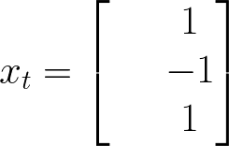

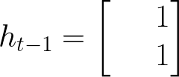
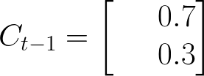

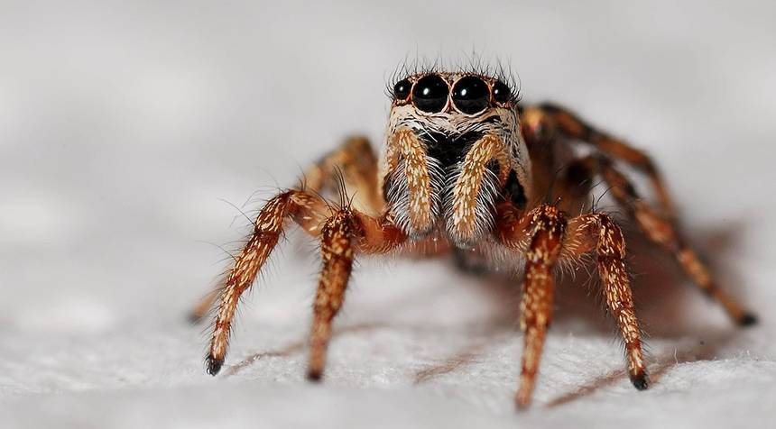



Let's think about my cell state
Let's predict if I will help you with the homework in time t

Slide 23
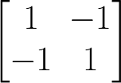
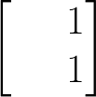
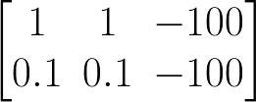
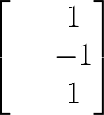
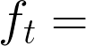


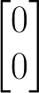
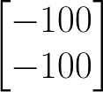
Forget Gate
The forget gate tries to estimate what features of the cell state should be forgotten.
Erase everything!

Slide 24
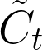
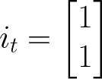
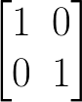
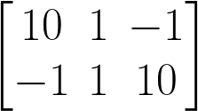
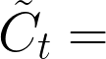

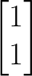
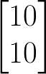
The input gate layer works in a similar way that the forget layer, the input gate layer estimate the degree of confidence of and is a new estimation of the cell state.
Input Gate
Let’s say that my input gate estimation is:

Slide 25
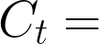
Cell state
After the calculation of forget gate and input gate we can update our cell state.
25

Slide 26
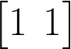
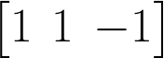



Output gate
The output gate layer is calculated using the information of the input x in time t and hidden state of the last step.
It is important to notice that hidden state used in the next step is obtained using the output gate layer which is usually the function that we optimize.

Slide 27
GRU
A variant of the LSTM is called the Gated Recurrent Unit, or GRU [Chung15]. The GRU is like an LSTM but with some simplifications. For instance, the forget and input gates are combined into a single gate [Olah15]. Since there’s a bit less work to be done, a GRU can be a bit faster than an LSTM. It also usually produces results that are similar to the LSTM [Chung14]. When working with RNNs, it’s often worthwhile to try both the LSTM and GRU to see if either provides more accurate results for a particular network and data set.

Slide 28

GRU (cont)

Slide 29







wcct! = we can calculate this!
To optimize my parameters i basically need to do:
Let’s calculate all the derivatives in some time t!
wcct!
wcct!
wcct!
wcct!
So… every derivative is wrt the cell state or the hidden state

Slide 30



Let’s calculate the cell state and the hidden state

Slide 31

RNN Structures
$$Y_{t }$$
The one to one structure is useless.
It takes a single input and it produces a single output.
Not useful because the RNN cell is making little use of its unique ability to remember things about its input sequence
$$X_{t }$$
one to one

Slide 32


RNN Structures (cont)
$$Y_{t }$$
﻿The many to one structure reads in a sequence and gives us back a single value.
Example: Sentiment analysis, where the network is given a piece of text and then reports on some quality inherent in the writing. A common example is to look at a movie review and determine if it was positive or negative.
$$X_{t−2 }$$
$$X_{t−1 }$$
$$X_{t }$$
many to one

Slide 33




RNN Structures (cont)
$$Y_{t−2 }$$
$$Y_{t−1 }$$
$$Y_{t }$$
The one to many takes in a single piece of data and produces a sequence.
For example we give it the starting note for a song, and the network produces the rest of the melody for us.
$$X_{t−2 }$$
one to many

Slide 34


RNN Structures (cont)
$$Y_{t−2 }$$
$$Y_{t−1 }$$
$$Y_{t }$$
﻿The many to many structures are in some ways the most interesting. ﻿used for machine translation.
Example: Predict if it will rain given some inputs.
$$X_{t−2 }$$
$$X_{t−1 }$$
$$X_{t }$$
many to many

Slide 35
RNN Structures (cont)
$$Y_{t−1 }$$
$$Y_{t }$$
This form of many to many can be used for machine translation.
For example, the English sentence: “The black dog jumped over the cat”
In Italian as:
“Il cane nero saltò sopra il gatto”
In the Italia, the adjective “nero” (black) follows the noun “cane” (dog), so we need to have some kind of buffer so we can produce the words in their proper English.
$$X_{t−2 }$$
$$X_{t−1 }$$
many to many

Slide 36
Bidirectional
LSTM and RNN are designed to analyze sequence of values.
For example: ﻿Patrick said he needs a vacation.
he here means Patrick and we know this because Patrick was before the word he.
However consider the following sentence:
He needs to work more, Pavlos said about Patrick.
Bidirectional RNN or BRNN or bidirectional LSTM or BLSTM when using LSTM units.

Slide 37





Bidirectional (cond)
$$Y_{t−2 }$$
$$Y_{t−1 }$$
$$Y_{t }$$
﻿symbol for a BRNN
$$Y_{t }$$
previous state
previous state
$$X_{t }$$
$$X_{t−2 }$$
$$X_{t−1 }$$
$$X_{t }$$

Slide 38
Deep RNN
LSTM units can be arranged in layers, so that each the output of each unit is the input to the other units. This is called a deep RNN, where the adjective “deep” refers to these multiple layers.
Each layer feeds the LSTM on the next layer
First time step of a feature is fed to the first LSTM, which processes that data and produces an output (and a new state for itself).
That output is fed to the next LSTM, which does the same thing, and the next, and so on.
Then the second time step arrives at the first LSTM, and the process repeats.

Slide 39







Deep RNN
$$Y_{ }$$
$$Y_{t−2 }$$
$$Y_{t−1 }$$
$$Y_{t }$$
$$Y_{t+1 }$$
$$Y_{t+2 }$$
$$X_{ }$$
$$X_{t−2 }$$
$$X_{t−1 }$$
$$X_{t }$$
$$X_{t+1 }$$
$$X_{t+2 }$$

Slide 40

Sequence to Sequence

Slide 41

Attention models
Source – https://github.com/google/seq2seq

Slide 42
Skip Connections
Add additional connections between units d time steps apart
Creating paths through time where gradients neither vanish or explode
t-1
t
t+1

Slide 43
Leaky Units
Linear self-connections
Maintain cell state: running average of past hidden activations

Slide 44

Standard RNN
colah.github.io

Slide 45
Leaky Unit
✕
colah.github.io

